Slide 1
Annual General Meetings
Springs Road Property Limited
Superstore Properties Limited
First NZ Properties Limited
28 September 2020

Slide 2
Introduction
Chairmans address
Fraud Report
Springs Road Property Ltd
Superstore Property Ltd
First NZ Properties Ltd

Slide 3
Springs Road Property Ltd

Slide 4
Financial Highlights
SPRINGS ROAD PROPERTY LIMITED
Income of $905,980 down from $951,132
Profit before other expenses tax $474,668 up from $191,098
Profit after tax, reduced to $191,098 from $759,757
(due to write downs for Seismic strengthening $210k & fraud written off)
Value unchanged from $7,400,000 although allowance for rental reductions from Covid-19 has been allowed for.
Mortgage $1,937,500 interest rate 3.31% floating.

Slide 5
Financial Highlights
SPRINGS ROAD PROPERTY LIMITED
Dividend of 17 cents per share (nil last year).
NTA per share $1.69 reduced from $1.79.
Directors are considering the next dividend in November.

Slide 6
Secondary Market
Investment Services Ltd operates a secondary market, for the sale of shares and parcels in the managed companies.
The market has been illiquid over the last few months with virtually no sales during Covid-19.
Prices in general have remained static during the previous 12 months
Last trade price is:
- Springs Road Property $1.11 per share

Slide 7
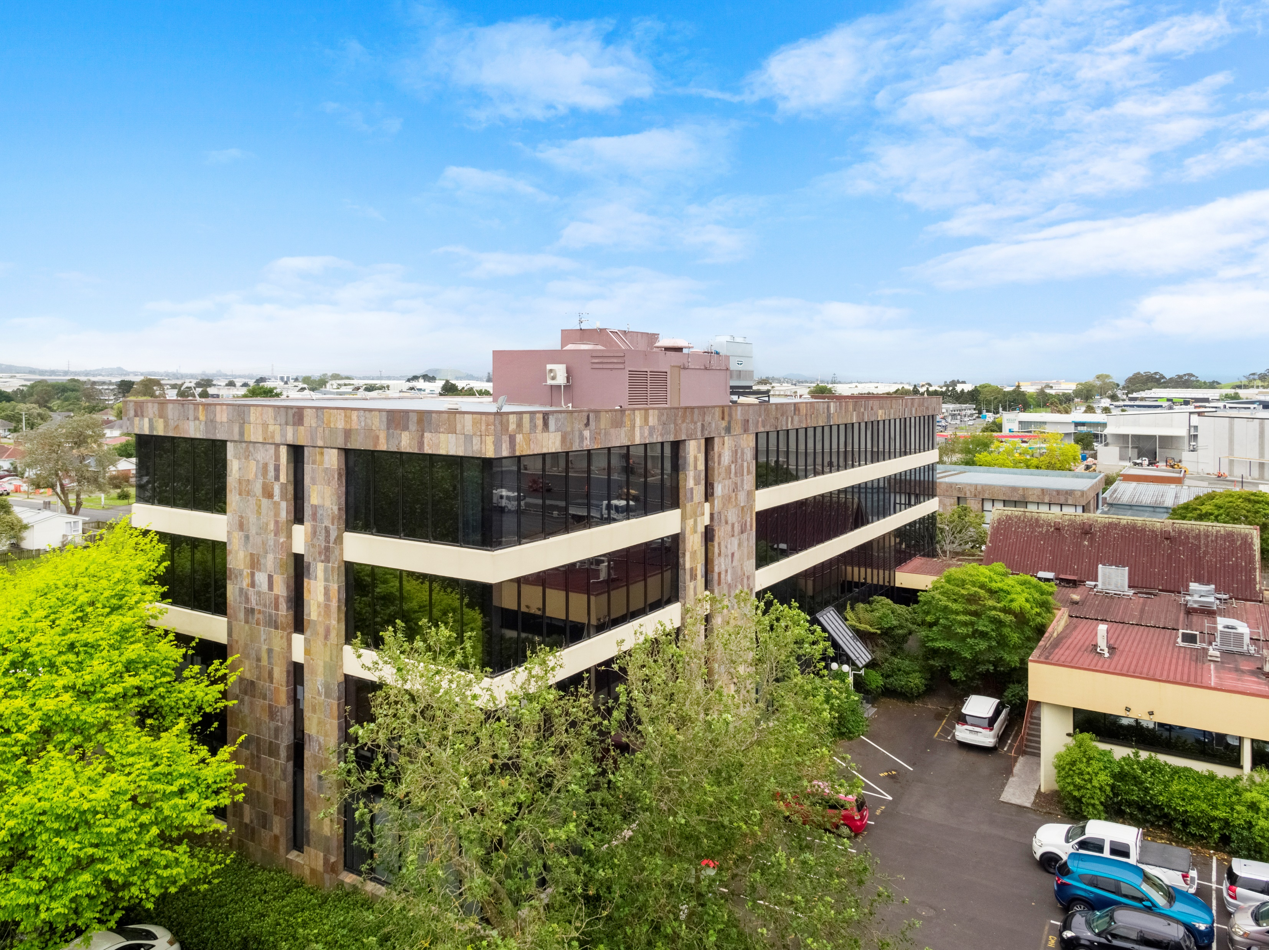
Springs Road Property Limited
7 Springs Road, East Tamaki, Auckland

Slide 8
Springs Road Property Limited
Tenants
Counties Manukau District Health Board
DAS Training Solutions Ltd (Sewtec Fashion Academy)
The Polyethnic Institute of Studies
Café Concepts Ltd (Dunkin Donuts)

Slide 9
7 Springs Road, Auckland
This building was constructed in the late 1980s as the headquarters of the Lion Nathan before passing on to Goodman Fielder. It is located on the corner of Springs Road and East Tamaki Road in south Auckland. The main building and rear annex offer a total of 3,700sq metres of office space together with basement storage. There are 171 car parking spaces.
2nd & 3rd Floors - Counties Manukau District Health Board
CMDHB originally leased 1,600sqm on the top two floors, along with a part of the basement in 2006. There have been a number of lease renewals through until 2018, when their lease expired. We agreed a new lease of 3 years with one 3 year renewal, through until 2024. They are now leasing 92 carparks, the two full floor levels and all basement storage. The rent is now $350,000pa with annual 3% reviews.
1st Floor - DAS Training Solutions Ltd (Sewtec Fashion Academy)
Following a 3 year term DAS would only renew for one year and vacated the 806sqm of first floor offices at the end of last year. However, we have recently negotiated a new lease with Te Rito Foundation for the full floor and 35 carparks for 4 years with two rights of renewal of 4 years each, from December. The rent is $169,000pa with CPI+1% annual increases.

Slide 10
7 Springs Road, Auckland
Ground Floor South – Skill NZ Ltd/The Polyethnic Institute of Studies
Half of the ground floor and 10 carparks was leased at market rent to the Institute in 2017 for 4 years until 2021. They have two rights of renewal of three years each, taking them through to 2027. The current rent is $60,000pa with market reviews every two years.
Ground Floor North - Vacant
Counties Manukau DHB vacated this office space of 374sqm and 17 carparks at the end of last year. Agents have been seeking new tenants and we are currently in negotiations with two prospective groups. The asking rent is around $70,000pa.
Café Concepts Ltd ( Dunkin’ Donuts) – Rear Annexe
As the NZ baker of Dunkin’ Donuts, Café Concepts took a 6 year lease of the rear annexe building and 14 carparks through until 2022. They have invested heavily in their commercial fit-out. They have one right of renewal of 7 years until 2029. The rent is $76,000pa with a review due upon renewal in 2022.
The total rental income is currently $486,000pa, but will increase to $655,000 at the end of this year.

Slide 11
AGM Business Springs Road Property Ltd Voting

Slide 12
Superstore Property Ltd

Slide 13
Financial Highlights
SUPERSTORE PROPERTIES LIMITED
Income increased from $1,477,121 to $1,554,094, on increased rentals.
Profit before Tax increased from $986,877 to $1,201,529
Mortgage finance costs reduced from $419k to $385k, with decreasing interest rates.
Property Valuations reduced slightly from $22,000,000 to $21,950,000 this was an allowance for Covid-19 rental reductions.
Mortgage of $9,924,000 expiring at 30th of October 2020, ANZ have indicated that this will be renewed at an interest rate of around 3.31%

Slide 14
Financial Highlights
SUPERSTORE PROPERTIES LIMITED
NTA per share decreased $5.44 from $5.46.
Earnings per share has increased from 36cents to 45cents.
Dividend 48cents per share, with no dividend last year.
The directors will be considering a dividend for November this year.

Slide 15
Secondary Market
Investment Services Ltd operates a secondary market, for the sale of shares and parcels in the managed companies.
The market has been illiquid over the last few months with virtually no sales during Covid-19.
Prices in general have remained static during the previous 12 months
Last trade price is:
- Superstore Properties $4.15 to $4.20 per share

Slide 16
Superstore Properties Limited
The Warehouse
483 Cameron Road, Tauranga
Placemakers
315 - 321 Cranford Street, Christchurch

Slide 17
The Warehouse, Tauranga

Slide 18
The Warehouse, Tauranga
483 Cameron Road, Tauranga is a traditional mid 1990’s warehouse with an 103% NBS assessment, providing 5,015m2 of storage and retail space.
Our original lease to The Warehouse Limited was in 1999 for 3 years with a four 3 year renewals.
In 2014 we successfully negotiated a new 10 year lease ending in 2025. The lease includes three rights of renewal through to 2037. The current rent is $865,000pa, following a recent rent review. TWL are also repaying $40,000pa against an improvements loan until 2025. The next rent review is due in 2022.
The building is in good condition. Some minor repairs have been carried out but nothing major is planned, although the exterior of the building will require redecorating soon. As the paint has faded to pink TWL are likely to be putting pressure on for this shortly.

Slide 19
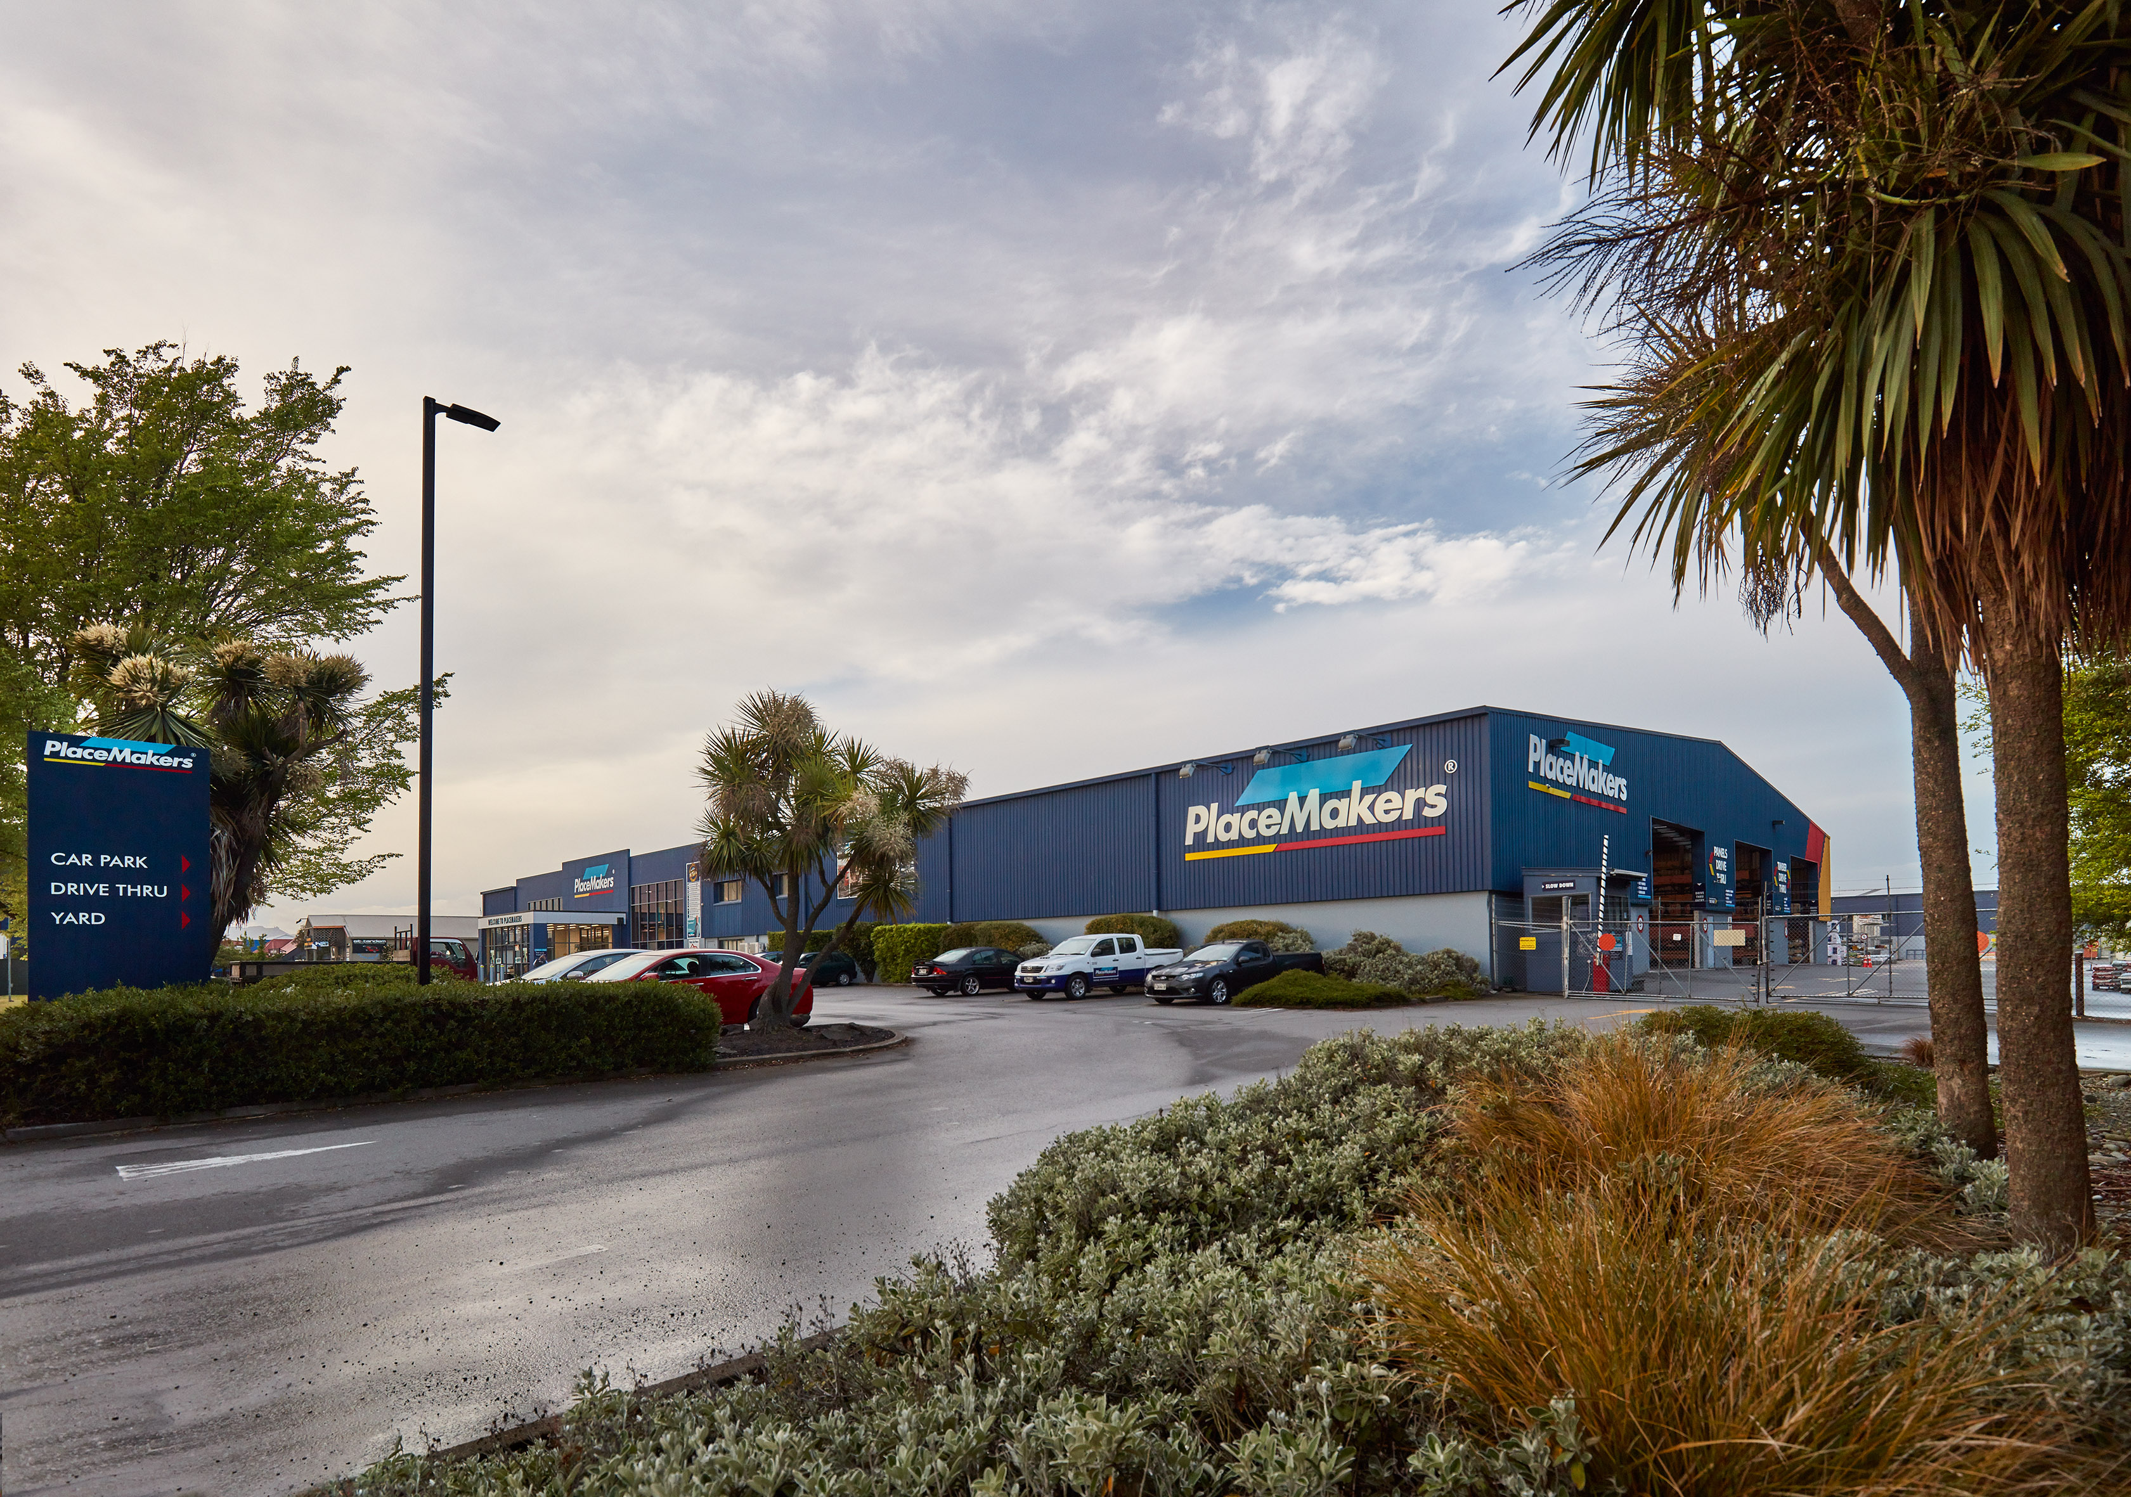
Placemakers, Christchurch

Slide 20
Placemakers, Christchurch
315 – 321 Cranford Street, Christchurch comprises two traditional late 1990’s warehouses providing a total of 4360sqm of retail, drive-through, office and storage space with a 67% NBS assessment.
The original lease to Placemakers was for 12 years from 1998. It included two rights of renewal of 4 years taking it through to 2018.
In 2014 we negotiated a new lease through until February 2022 with three renewals of 6 years each, taking it through until 2040.
The rent was reviewed in 2019 increasing it to $625,000pa with the next review due in February 2022. Placemakers are also paying an additional improvements rent of $46,842pa until 2022.
The earthquake damage repairs to the superstructures of the buildings are now complete. All repairs have been paid for by insurers. The replacement of the unlevel drive-through concrete floor and adjacent driveway has been agreed with insurers. These repairs are difficult to carry out whilst the tenant is in place and settlement is being agreed so that the work can be carried out at a later date.

Slide 21
AGM Business Superstore Properties Ltd Voting

Slide 22
First NZ Properties Ltd

Slide 23
Property Events
Sale of 110 Symonds Street.
Purchase of 234 Rangitikei Street, Palmerston north (post YE).

Slide 24
Sale of 110 Symonds Street.
Purchased in 2012 for $26m partially with funds from the insurance money at 50 Kilmore street. The insurance company made it a requirement of the settlement that the funds be spent on a replacement building so it could not be distributed to investors.
The property was sold following a marketing campaign for $38,000,000 which included a $3,000,000 underwrite for the rental spread over 2 years (funds held by our lawyer since settlement). It was sold as the property had become more difficult to lease out and was likely to require a substantial upgrading program over the next few years, the market value was $35,300,000 at the previous valuation.
It was a good result to increase the shareholder funds by approximately $8.3M (after fees) over a 7 year period, this equates to an increase in shareholder value by $2.04 per share or around 4.7% compounding growth through that time.
Purchase of 234 Rangitikei Street, Palmerston North.
The directors felt that the best use of funds for the company was to purchase another property, they searched the entire country to find one that suited their criteria:
Geographically diverse from Christchurch.
High return (7.5% achieved).
Multiple tenancies.
Predominantly national tenants.
Area had to have a strong local growing population.
Seismically strong building.
No land or property issues

Slide 25
234 Rangitikei Street, Palmerston North, fitted this criteria.
Due diligence was started in February with confirmation in April (aside from the vendors having to get a Code of Compliance for minor works) settlement was the 14th of May 2020.
Since settlement:
No rentals have been missed or reductions requested by the tenants.
Uncle Bills have advised the they will be renewing their lease for 6 years.
Commercial property Capitalisation rates have further reduced.
The likelihood is that the value of the property has improved since the settlement.
The property was purchased with cash on hand, opening the scope to further improving the company by the purchase of another property by way of a conservative mortgage secured against all of the companies assets.

Slide 26
Financial Highlights
FIRST NZ PROPERTIES LIMITED
Income YE March 2020, $1,004,167 previous year $3,150,671.
This reduction is related to the sale of 110 Symonds Street.
Profit before tax (continuing operations) profit of $525,619 YE 2019 to a loss of $1,836,844, the reduction was mainly due to seismic write off against the valuation.
Discontinued operations (includes sale of 110 Symonds) profit of $288,088 (including tax).
Assets as at 31st March 2020
Property $9,340,000 (includes an allowance for $2m for seismic strengthening)
Cash on deposit $12,000,000.
Cash operating account $2,800,000
Mortgage Nil.
NTA decreased from $6.58 to $5.89.
Dividend of 27cents per share – compared to 13cents per share the previous year.

Slide 27
First NZ Properties Ltd
234 Rangitikei Street, Palmerston North
Various tenants
15 Sheffield Crescent, Christchurch
NZ Yarns Ltd

Slide 28
234 Rangitikei Street

Slide 29
234 Rangitikei Street
210 – 234 Rangitikei Street in Palmerston North was purchased for $11.5m earlier this year. It comprises two equal warehouse style buildings built in 2008, totaling 4100sqm of retail space including storage and mezzanine offices. The buildings have a 100% NBS assessments. The buildings and 107 carparks are in good condition.
The original lease to Harvey Norman of 2040sqm was for 8 years from 2008. It included two rights of renewal of 5 years each taking it through to 2026. A later variation added another right of renewal through to 2031. The next renewal is due in October 2021. The current gross rent is $473,000pa. CPI rent reviews are applied annually.
Bed Bath and Beyond originally leased 695sqm in 2016 for ten years with two 5 year renewals through until 2036. They increased that space to 1,230sqm in 2019 and are in the process of completing their fit-out. Rent increases are agreed at 3% per annum with market reviews on renewal.
Price Busters/Uncle Bills Wholesale Club originally leased 812sqm in 2009 for 6 years with a 6 year right of renewal through to 2021. We have recently agreed an extension of the lease to 2027 with another 6 year right of renewal to 2033 at $162,000pa. Rent reviews are fixed at 1%pa.

Slide 30
15 Sheffield Crescent, Christchurch

Slide 31
15 Sheffield Crescent, Christchurch
The property is a 14,285m2 factory on a 3 hectare industrially zoned site in Burnside, on the northern outskirts of Christchurch. It is central to the busy Sheffield Crescent industrial and office estate. The estate has improved dramatically since the Christchurch earthquakes and now joins with the Sir William Pickering Drive development.
In 2014, following the bankruptcy of our previous tenant amid major earthquake damage repairs, we negotiated a new 10 year lease with NZ Yarns Ltd. This lease ends in 2024 but has four 3 year renewals through until 2036. The tenant has invested improving heating, ventilation and has sub-leased to incorporate associated businesses to form a ‘Wool Hub’. The current rent is just over $1m per annum following a CPI review late last year.
Substantial landlord repairs have been necessary to the roof coverings and more are anticipated in the future. We recently received a Detailed Structural Assessment on the building. We have initiated $300,000 of initial improvements and have another 15 years to complete further improvements estimated at $1.7m to achieve a higher NBS rating.

Slide 32
Secondary Market
Investment Services Ltd operates a secondary market, for the sale of shares and parcels in the managed companies.
The market has been illiquid over the last few months with virtually no sales during Covid-19.
Prices have remained static during the previous 12 months
Last trade price is $4.20
- With listings currently $4.20 to $5.00 per share

Slide 33
AGM Business First NZ Properties Ltd Voting

Slide 34
Meeting Close
Thankyou for attending.

