Slide 1
Annual General Meetings
Superstore Properties Limited
First NZ Properties Limited
Springs Road Property Limited
24 September 2019

Slide 2
Agenda
Introduction
Property portfolio overview
Secondary market
Financial review
AGM business
Close.

Slide 3
Property Portfolio Overview

Slide 4
Superstore Properties Limited
The Warehouse
483 Cameron Road, Tauranga
Placemakers
315 - 321 Cranford Street, Christchurch

Slide 5
The Warehouse, Tauranga

Slide 6
The Warehouse, Tauranga
483 Cameron Road, Tauranga is a traditional mid 1990’s warehouse with an A+ seismic rating, providing 5,015m2 of storage and retail space.
Our original lease to The Warehouse Limited was in 1999 for 3 years with a four 3 year renewals.
In 2014 we successfully negotiated a new 10 year lease ending in 2025. The lease includes three rights of renewal through to 2037. The current rent is $825,000pa, which is very slightly above market. TWL are also repaying $40,000pa against an improvements loan until 2025. The next rent review is due in 2019.
The building is in good condition with no impending major repairs, although the exterior of the building will require redecorating within the next two years.

Slide 7
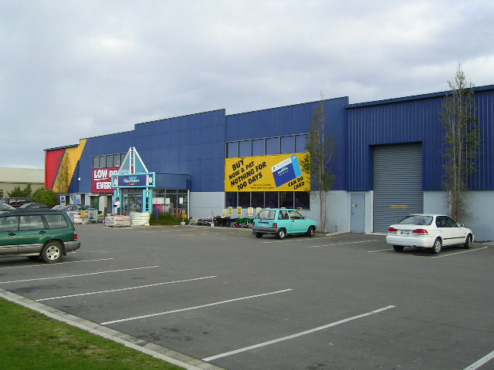
Placemakers, Christchurch

Slide 8
Placemakers, Christchurch
315 – 321 Cranford Street, Christchurch comprises two traditional late 1990’s warehouses providing a total of 4360sqm of retail, drive-through, office and storage space with a 67% seismic rating.
The original lease to Placemakers was for 12 years from 1998. It included two rights of renewal of 4 years taking it through to 2018.
In 2014 we negotiated a new lease through until February 2022 with three renewals of 6 years each, taking it through until 2040.
The rent was reviewed in February 2016 increasing it to $611,000pa which is now very slightly below market rent, with the next review due in February 2019. Placemakers are also paying an additional improvements rent of $46,842pa until 2022.
The buildings, carparks and driveways suffered in the Christchurch earthquakes. The repairs to the superstructures of the main and logistics building are now complete. Voids beneath the concrete floors of the buildings are currently being grout filled and the driveways will be reinstated once the works to the buildings are complete. All works have been paid for by insurers.

Slide 9
First NZ Properties Ltd
110 Symonds Street, Auckland
Various Tenants
15 Sheffield Crescent, Christchurch
NZ Yarns Ltd

Slide 10
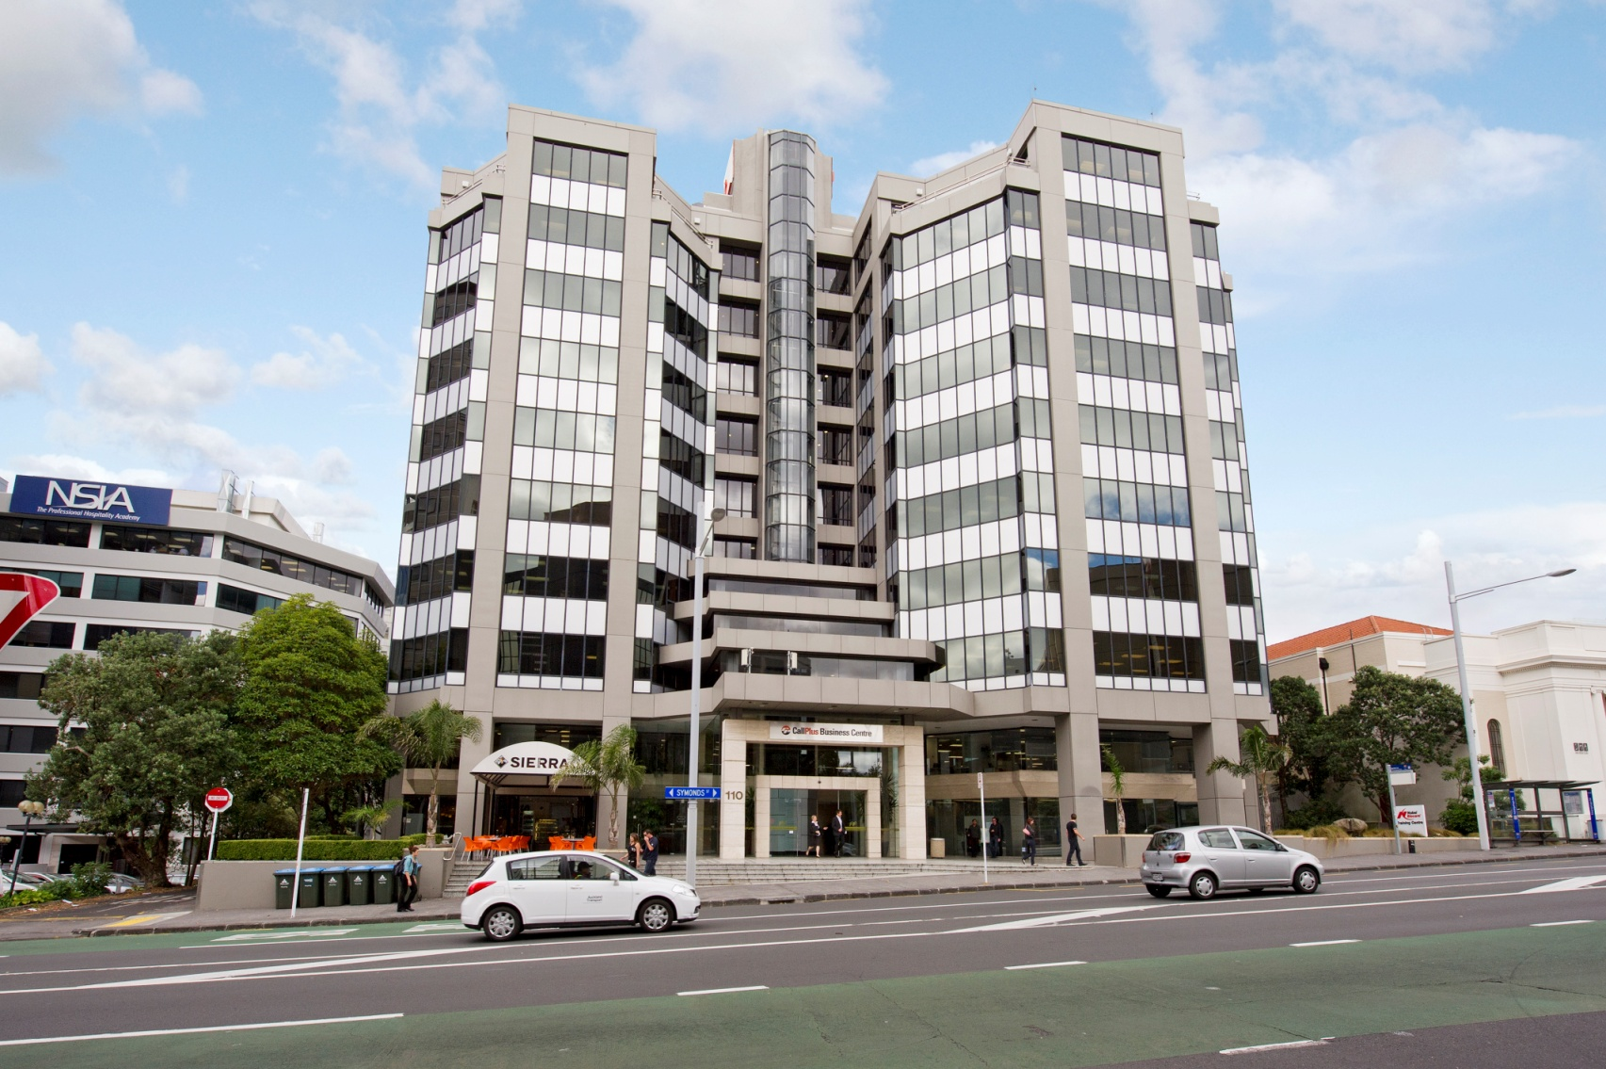
110 Symonds Street, Auckland

Slide 11
110 Symonds Street, Auckland
The building provides 9,000m2 of retail and office space over 10 floors, with a further 3 basement floors of parking for 168 cars. The building was constructed in the late 1980’s and has an A grade seismic rating.
Symonds Street is on the southern fringe of the Auckland CBD in a popular area of offices, apartments, hotels and many Auckland University properties.
The 14 tenants are a broad mix including the Protecta and BrokerWeb Insurance, Syngenta, Trade Me, the NZ Institute of Fashion, TV media accountancy firms, call answering services, and the Auckland Catholic Diocese offices. There is a popular Sierra Café at ground level. Vocus Communications vacated three floors earlier this year leaving vacant space of 3,200m2, Agents are advertising the space and are showing a number of prospective tenants through. We have arranged the refurbishment of the front entrance and lifts and the redecorating of the exterior of the building.
There are varied tenancy renewal dates and rent reviews. Several tenants have recently renewed there leases and two have moved within the building. The current total rental income is nearly $1.7m.

Slide 12
15 Sheffield Crescent, Christchurch

Slide 13
15 Sheffield Crescent, Christchurch
The property is a 14,285m2 factory on a 3 hectare industrially zoned site in Burnside, on the northern outskirts of Christchurch. It is central to the busy Sheffield Crescent industrial and office estate. The estate has improved dramatically since the Christchurch earthquakes and now joins with the Sir William Pickering Drive development.
In 2014, following the bankruptcy of our previous tenant amid major earthquake damage repairs, we negotiated a new 10 year lease with NZ Yarns Ltd. This lease ends in 2024 but has four 3 year renewals through until 2036.
The current rent is just over $1m per annum following a CPI review late last year.
Substantial landlord repairs have been necessary to the roof coverings and more are anticipated in the future. Meanwhile, the tenant has invested in improved heating, ventilation and has sub-leased to incorporate associated businesses to form a ‘Wool Hub’.

Slide 14
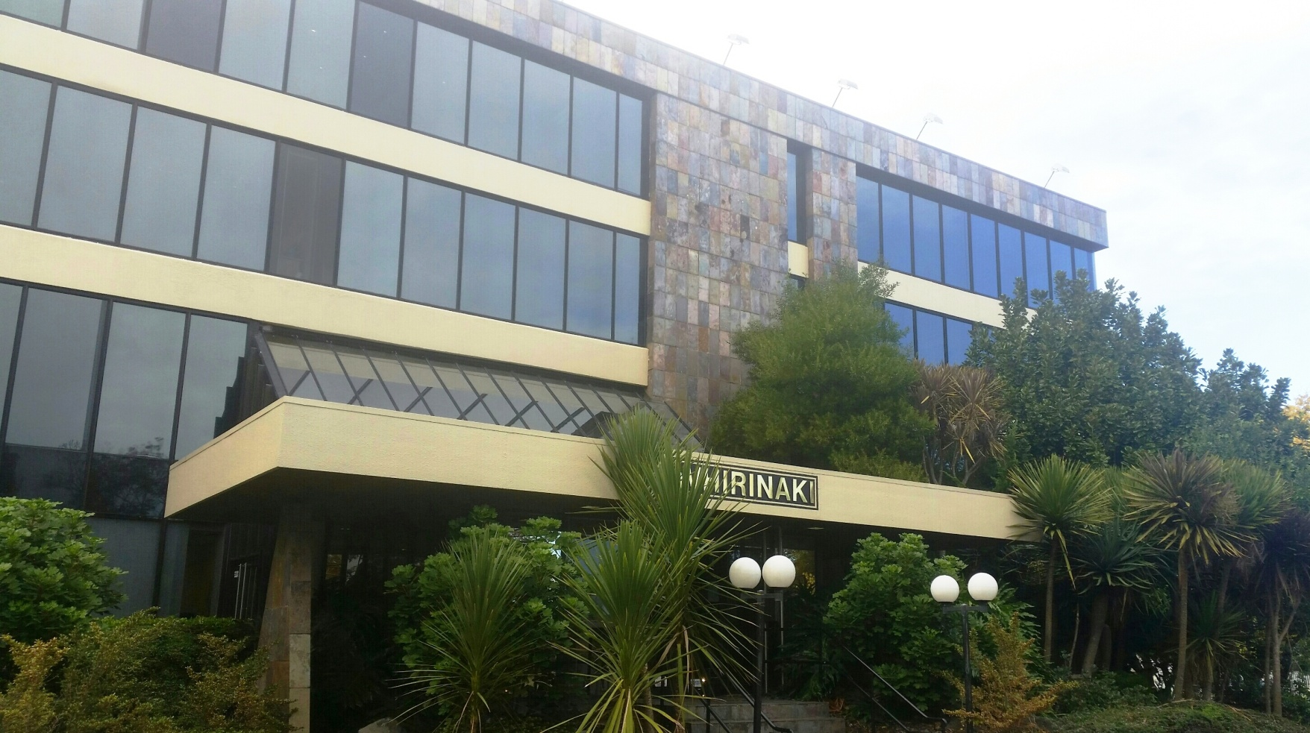
Springs Road Property Limited
7 Springs Road, East Tamaki, Auckland

Slide 15
Springs Road Property Limited
Tenants
Counties Manukau District Health Board
DAS Training Solutions Ltd (Sewtec Fashion Academy)
The Polyethnic Institute of Studies
Café Concepts Ltd (Dunkin Donuts)

Slide 16
7 Springs Road, Auckland
This building was constructed in the late 1980s as the headquarters of the Lion Nathan before passing on to Goodman Fielder. It is located on the corner of Springs Road and East Tamaki Road in south Auckland. The main building and rear annex offer a total of 3,700sq metres of floor space together with basement storage. There are 171 car parking spaces. All floors and carparks are now fully leased.
Counties Manukau District Health Board - 2nd & 3rd Floors
CMDHB originally leased the top two floors, along with a part of the basement in 2006. There have been a number of lease renewals through until 2018, when their lease expired. We have very recently agreed a new lease of 3 years with one 3 year renewal, through until 2024. They are now leasing 92 carparks and all basement storage. The rent has increased from $275,000pa to $329,000 with annual reviews.
DAS Training Solutions Ltd (Sewtec Fashion Academy) – 1st Floor
A lease of the first floor and 17 car parking spaces was agreed with Sewtec, a fashion education school, in 2016. The initial 3 year term is at market rental, with one right of renewal until 2022. We have recently commenced negotiations with them around their renewal and rent review due in January 2019.

Slide 17
7 Springs Road, Auckland
Counties Manukau District Health Board – Half Ground Floor
In 2012 we negotiated a separate additional 4 year lease with CMDHB of half of the ground floor and 35 more carparks. The initial term has recently been renewed until 2019 and there is another 3 year right of renewal which would take them through to 2022.
The Polyethnic Institute of Studies – Half Ground Floor
The remaining half of the ground floor and 10 carparks was leased at market rent to the Institute in 2017 for 4 years until 2021. They have two rights of renewal of three years each, taking them through to 2027.
Café Concepts Ltd ( Dunkin’ Donuts) – Rear Annexe
As the NZ baker of Dunkin’ Donuts, Café Concepts took a 6 year lease of the rear annexe building and 14 carparks through until 2022. They have invested heavily in their commercial fit-out. They have one right of renewal until 2029. The first rent review is due in February 2018.
The total rental income is currently $640,000pa.

Slide 18
Secondary Market
Investment Services Ltd operates a secondary market, for the sale of shares and parcels in the managed companies.
The market has been very liquid over the last 12 months with a great many trades taking place and a waitlist of buyers
Prices being demanded (in general) have remained at the last sale prices during the previous 12 months
Last trade prices are
Superstore Properties $4.35 per share
Springs Road Property $1.16 per share
First NZ Properties $4.70 per share

Slide 19
Presentation of Financial Highlights Year ended 31 March 2018

Slide 20
Financial Highlights
SUPERSTORE PROPERTIES LIMITED
Property valuations increased by $580,000 on top of $600,000 last year
Operating profit of $877,936 compared to $633,000 last year.
NTA per share increased to $5.10 from $4.90
Overall debt/valuation ratio dropped from 48% to 47%

Slide 21
Return on investment
Current ROI
41 cents per share
% return on par 41%
% return based on current trade price 9.43%
Forecast Dividend - 2019 year
- Interim 0.16 cents
- Final 0.24 cents

Slide 22
Financial Highlights
FIRST NZ PROPERTIES LIMITED
Property valuations increased by $1,100,000 on top of the $3,980,000 last yeat
Debt to valuation - 41% vs 42% prior year.

Slide 23
Financial Highlights
Operating profit of $1.56m vs $1.29 prior year
NTA improved from $6.41 to $6.66 per share
Dividends 40 cents per share

Slide 24
Return on investment
Per share
40 cents per share
% return on per share at par 40.0%
% return based on trade price $4.70 8.5%

Slide 25
Financial Highlights
SPRINGS ROAD PROPERTY LIMITED
Operating profit of $240,000 against a 2017 profit of 230,000
NTA per share $1.52
Debt to valuation ratio remains at 29%

Slide 26
Return on investment
Per parcel
Mortgage bond interest averaged 6.40%
Special dividend of .08 cents per share following conversion
% return on per parcel at par 13.12%
% return based on last trade price 11.51%

Slide 27
Mortgage Bond Conversion
Mandatory conversion of mortgage bonds took place on 16 January 2018 being the 20th anniversary of their issue.
Each $4,000 bond was settled by the issue of 4,000 shares
From that date future distributions will by way of dividend
Forecast Dividend 2019 16 cents per share

Slide 28
AGM Business

